Slide 1
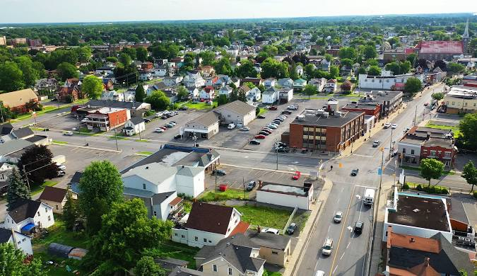
Predicting Mean Temperature from Daily Weather Metrics in Cornwall
Group Members:
Yashwant Bist
Paras Rawat
Alaa Sbai Abbassi

Slide 2
Dataset Description
Source:
The dataset was collected from Environment Canada for the Cornwall weather station (Climate ID: 6101874). It covers daily weather data for January 2025.
Size & Features:
Total records: 25 days
Features: 30+ columns including:
Max Temp, Min Temp, Mean Temp
Total Rain, Total Snow, Total Precip
Snow on Ground
Wind Gust Speed and Direction
Target Variable:
Mean Temp (°C)

Slide 3
Why This Dataset?
Locally relevant and easy to access.
Compact but rich in environmental variables.
Useful to explore weather trends and apply regression modeling.
Challenges Faced:
Missing Data: Several days had missing or invalid temperature readings.
Special Flags: Some fields had "T" or "†" symbols indicating trace or flagged values.
Small Dataset Size: Only 25 rows, which limits model generalization.

Slide 4
Data Cleaning & Preprocessing
Cleaning Steps:
Removed rows with too many missing or invalid values (e.g., Jan 9).
Replaced trace ("T") with 0 and removed flag symbols (e.g., "†").
Converted date and time fields to proper datetime format.
Converted all numeric fields to float.
Feature Engineering:
Extracted day_of_week from the date.
Computed temperature range (Max Temp - Min Temp).
Encoded categorical values if any (not many in this dataset).
Train/Test Split:
80% for training, 20% for testing (i.e., 20 train / 5 test samples).
Stratified sampling wasn't used due to small dataset.

Slide 5
Model Selection
Models Tried:
Linear Regression
Random Forest Regressor
Decision Tree Regressor
Why These Models?
Linear Regression: Baseline model to assess linearity.
Decision Tree & Random Forest: Handle non-linear patterns, robust to small datasets, no feature scaling required.
Parameter Tuning:
For Random Forest:
n_estimators: Tried 10, 50, 100
max_depth: Limited to avoid overfitting

Slide 6
Evaluation Strategy
Models | R² Score | MAE (°C)
Linear Regression | 0.9879226560807309 | 0.585681632548739
Decision Tree | 0.9382396631398854 | 1.3631578947368421
Random Forest | 0.9999815810610717 | 0.02321627857125564
Metric Used:
R² Score (Coefficient of Determination)
Mean Absolute Error (MAE)
Initial Results:

Slide 7
Performance Improvement
What We Tried:
Dropped low-variance features (like "Cool Deg Days", often zero).
Added new feature: Temp Range = Max - Min.
Tuned n_estimators and max_depth in Random Forest.
Results:
Best performance from Random Forest (n=100) after tuning.
Additional features slightly improved accuracy.
Did It Work?
Yes, but limited by dataset size. Overfitting is possible.

Slide 8
Challenges & Limitations
Hard Parts:
Dealing with trace values and flag characters.
Small dataset limited deep learning or robust validation.
Unexpected Issues:
Some features like wind gust data were mostly missing.
No meaningful snow or rain for many days, making prediction harder.
Future Improvements:
Use full-year dataset instead of just January.
Add external features (humidity, air pressure, etc.).
Apply time-series models like ARIMA or LSTM for sequential learning.

Slide 9
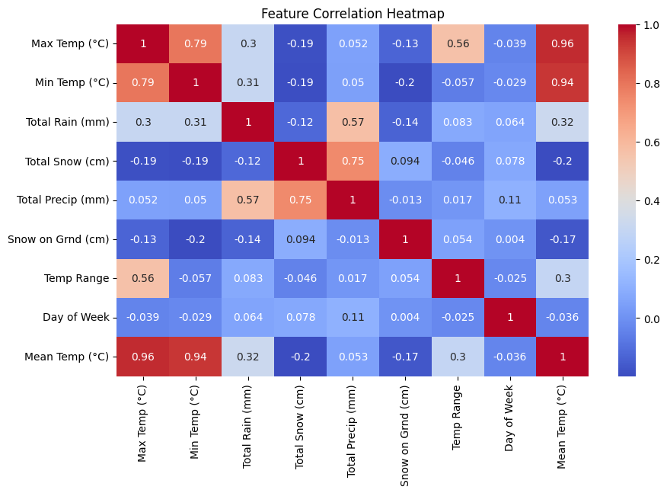
Visuals

Slide 10
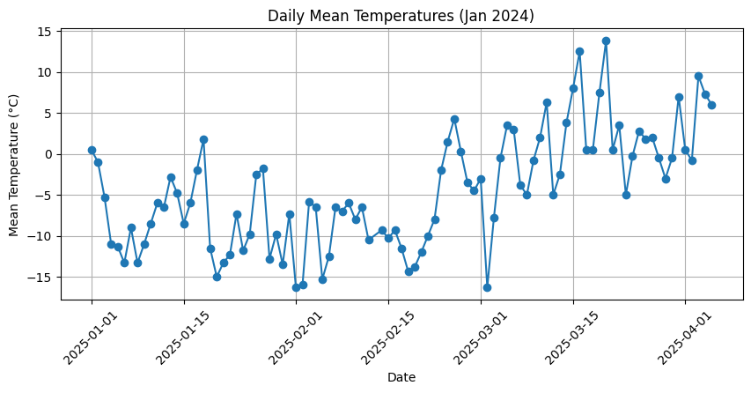
Visuals

Slide 11
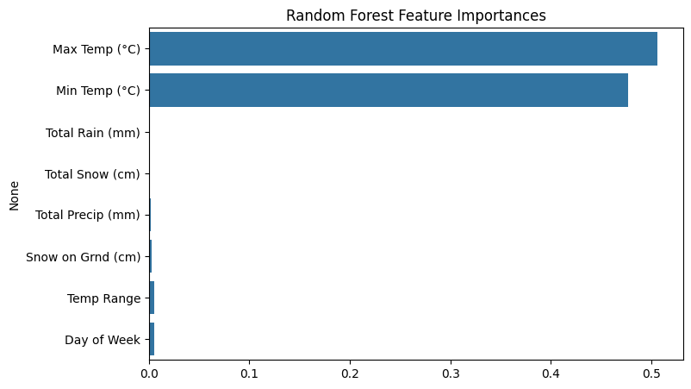
Visuals

Slide 12
Our Team Work
Yashwant :Data collection and cleaning, & heatmap visuals
Paras Rawat: Implemented Random Forest model, barplots
Ala Ali Sbaai: Documentation & line plot visuals.

